Slide 1
Kernel meetup pune
Extending Csmith for GCC C language extension
Sameeran Joshi
(joshisameeran17@gmail.com)
Shubham Narlawar
(shubhamnarlawar123@gmail.com)

Slide 2
Topics :
Original Csmith :
Random testing/stress testing
Survey of testing tools
Where did csmith come from? - randprog
Inventors of csmith
What they did till now
Csmith’s grammar
Current state of csmith
Csmith with extensions:
Where did it start from-GSoC?
Help! Help ! - csmith developers
Who then?
Implemented extensions
Fuzzing statistics-found a bug?
Announcing it-csmith list,gcc list
Future plans

Slide 3
Topics :
EXTENSIONS?
Original Csmith :
Random testing/stress testing
Survey of testing tools
Where did csmith come from? - randprog
Inventors of csmith
What they did till now
Csmith’s grammar
Current state of csmith
Csmith with extensions:
Where did it start from-GSoC?
Help! Help ! - csmith developers
Who then?
Implemented extensions
Fuzzing statistics-found a bug?
Announcing it-csmith list,gcc list
Future plans

Slide 4
DON’T BE SPECIFIC TO CSMITH,JUST ABOUT RANDOM TESTING AND SOME TESTING FUNDAS.

Slide 5
Survey of testing tools:
csmith:
1.McKeeman
2.Lindig
3.Sheridan
4.randprog
5.yarpgen
Modifying csmith
CLCsmith-opecl

Slide 6
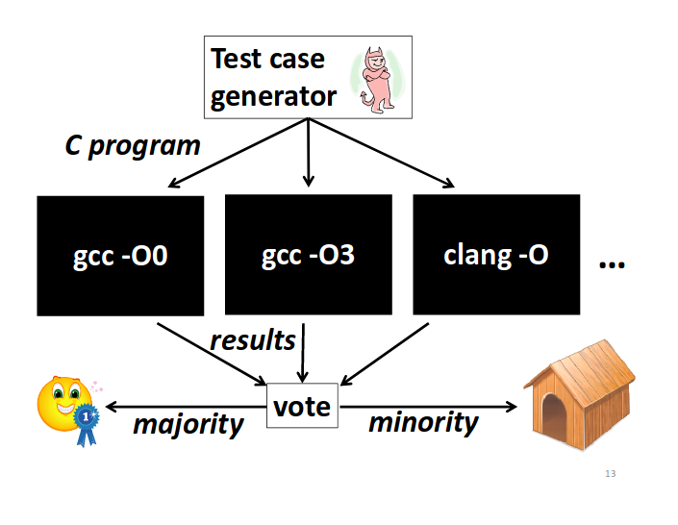

Slide 7
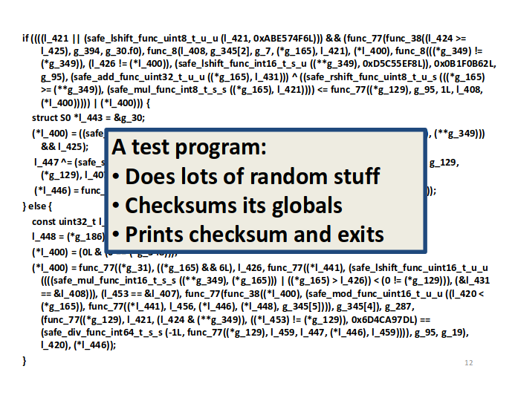

Slide 8
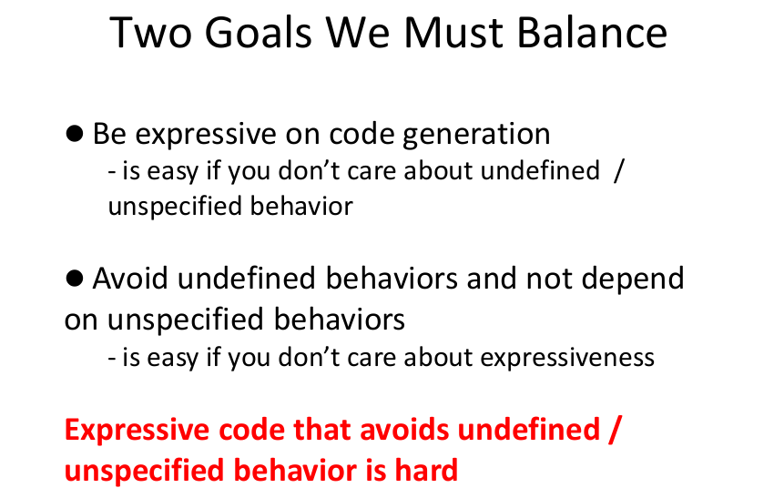

Slide 9
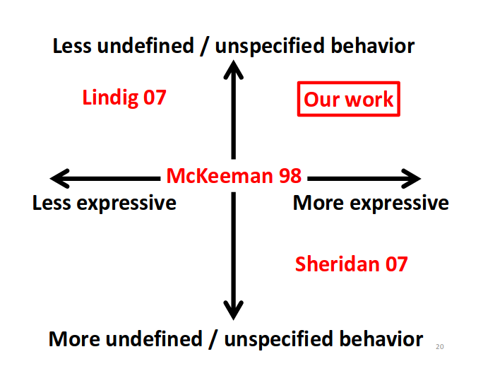

Slide 10
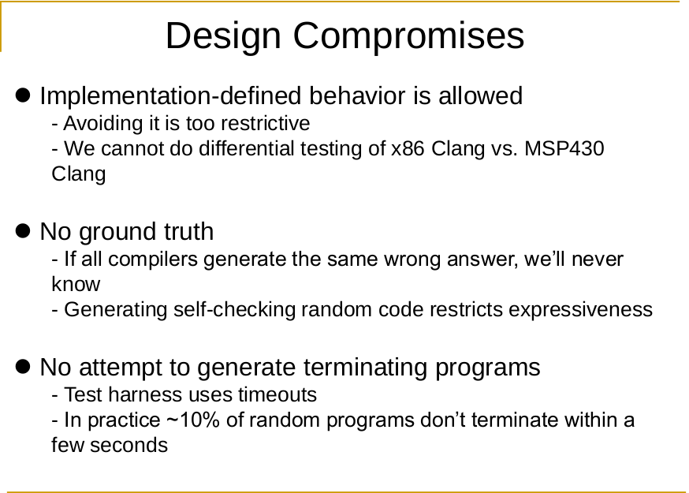

Slide 11
Sructure of random program:
Sections
headrs
structs
variables
function decl
functions
main
stastics

Slide 12
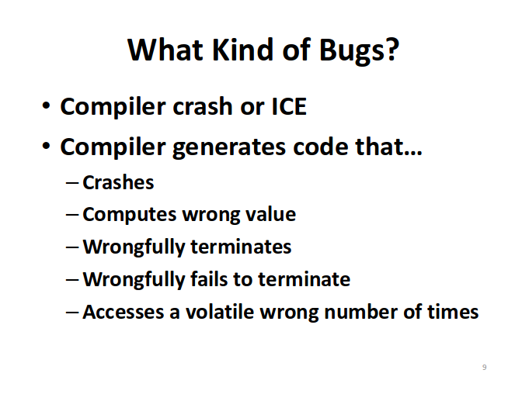

Slide 13
GRAMMER OF CSMITH
(out.pdf)

Slide 14
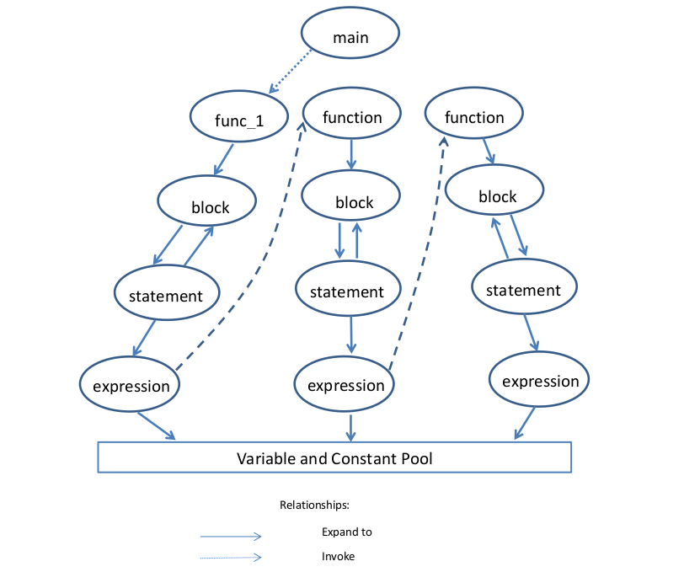

Slide 15
Uses of extensions in kernel

Slide 16
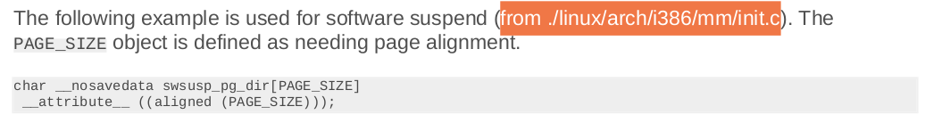

Slide 17
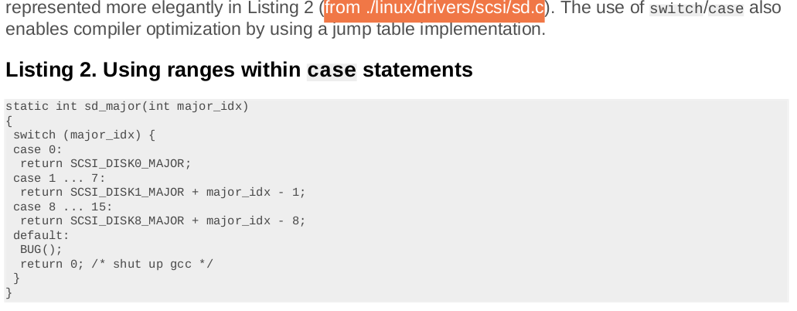

Slide 18
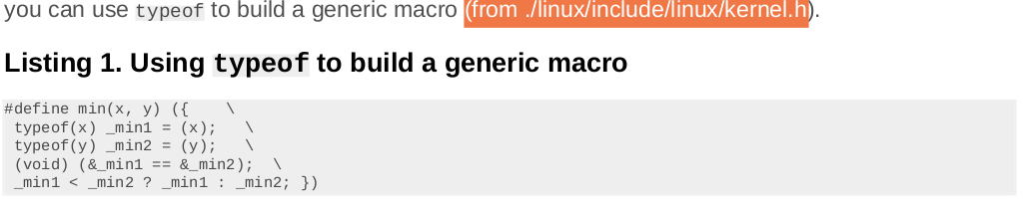

Slide 19
Categories we divided into:
1.very simple – just replace function.gen_binary_const()
In grammar →x|y|add_here
2.needs some more tweaking
3.derive own file and hence
Generate new rules in grammar
ex.switch case,macro

Slide 20
Implementation
Investigate documentation & scope
Sample program
Implement
Run fuzzing against compiler
Reduce if bug found – creduce
Report it

Slide 21
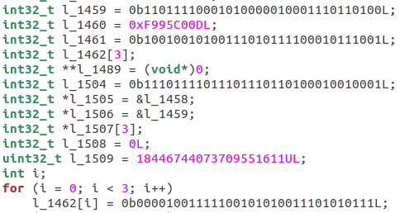
Binary constants:

Slide 22
__transaction_relaxed
static int32_t * func_39(int32_t p_40, int16_t p_41, uint16_t p_42, int16_t p_44)
{/* block id: 73 */
__transaction_relaxed {
int32_t *l_225 = &g_60[0][4][3];
return l_225;
}
}

Slide 23
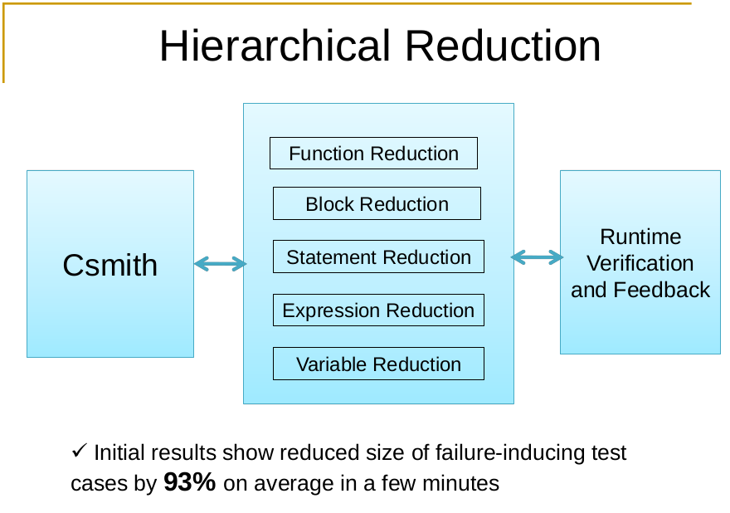

Slide 24
Our testing results:
Run 400K tests or more
Gcc[7.x] and [8.x]
Llvm =
-o2 -o1 I think 6/7 levels we have ran checkSO
Only on x86 and 200k on gcp vcpu (think xeon processor)

Slide 25
If needed to find the problems and solutions go for gcc ppts
ex.how to handle undefined

Slide 26
